Slide 1
Happiness Prediction: A Statistical Learning Approach
By:
Rabin Nepal (U00901360)
Dec. 6, 2023

Slide 2
Presentation Outline
Introduction
Problem Statement and Objectives
Dataset
Results
Discussion and Conclusion
References
Appendix

Slide 3
Introduction and Motivation
What is Happiness?
Oxford Dictionary: the state of being pleasurable contentment
Something abstract and subjective and hard to define and even harder to quantify but easy to experience
Motivation - Why Happiness?
Studying about happiness sheds lights on practical ways to improve lives.
Can help develop tools to promote a happier life for individuals and society as a whole.
Happiness drives us all.

Slide 4
Problem Statement and Objective
Problem Statement:
Predicting happiness: complex and challenging.
Accurately predicting happiness remains a significant challenge due to its complex and multifaceted nature.
Project Objectives:
Identify Key Factors: Uncover influential factors affecting happiness levels.
Happiness Prediction: Develop a model to predict happiness scores based on diverse factors.
Promote Well-being: Use data-driven insights to enhance well-being and satisfaction.
Overall, this project will be able to look into different factors affecting happiness, and train a model to predict a happiness score.

Slide 5
Dataset: World Happiness Report (An Overview)
World Happiness Report (WHR) Dataset
Comprehensive compilation of happiness levels across different countries.
Yearly report prepared by Sustainable Development Solutions Network (SDSN) using data from Gallup World Poll (subjective).
Covers over 150 countries, and includes data on various factors considered to contribute to happiness, such as income, social support, life expectancy, freedom, generosity, etc.
Data Available since 2012
Why not other dataset?
WHR Dataset is global (all countries) , comprehensive and accessible

Slide 6
Dataset - Clean Up
Dataset used for this study : 2015 to 2023
Number of variables ranged from 9 to 21, but all the years has 8 variables in common
Common columns among all year data:
("Country", "Happiness.Score", "GDP.per.Capita", "Social.Support", "Life.Expectancy"," Freedom", "Generosity", "Corruption")
All the variables except “Country” are numerical
Dataset was filtered by the common columns
NA values were filtered
Later rbind(), scaled and Train-Test Split (9:1)

Slide 7
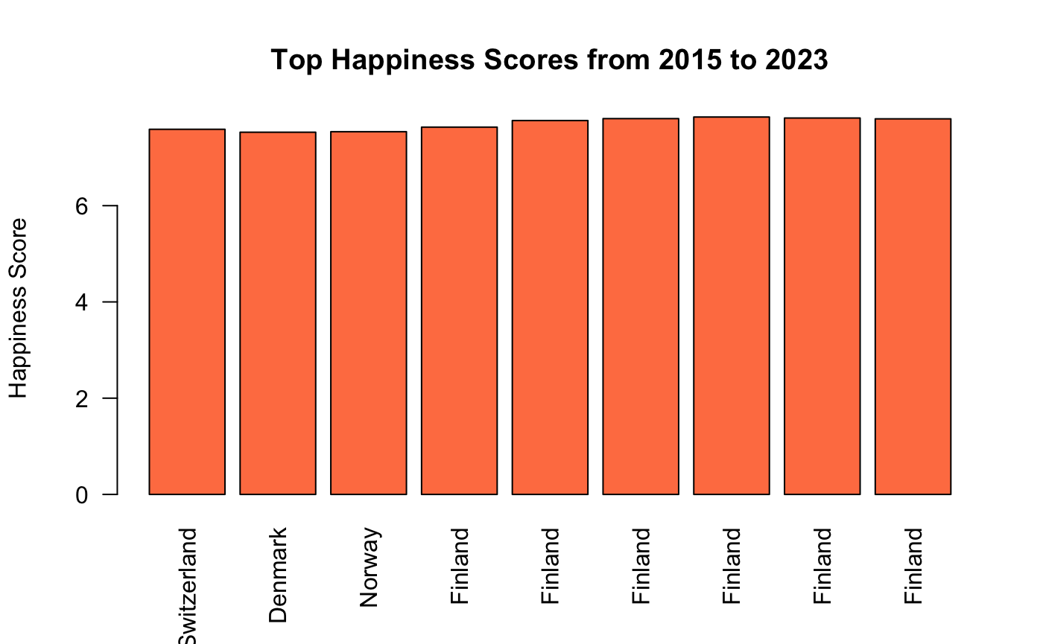
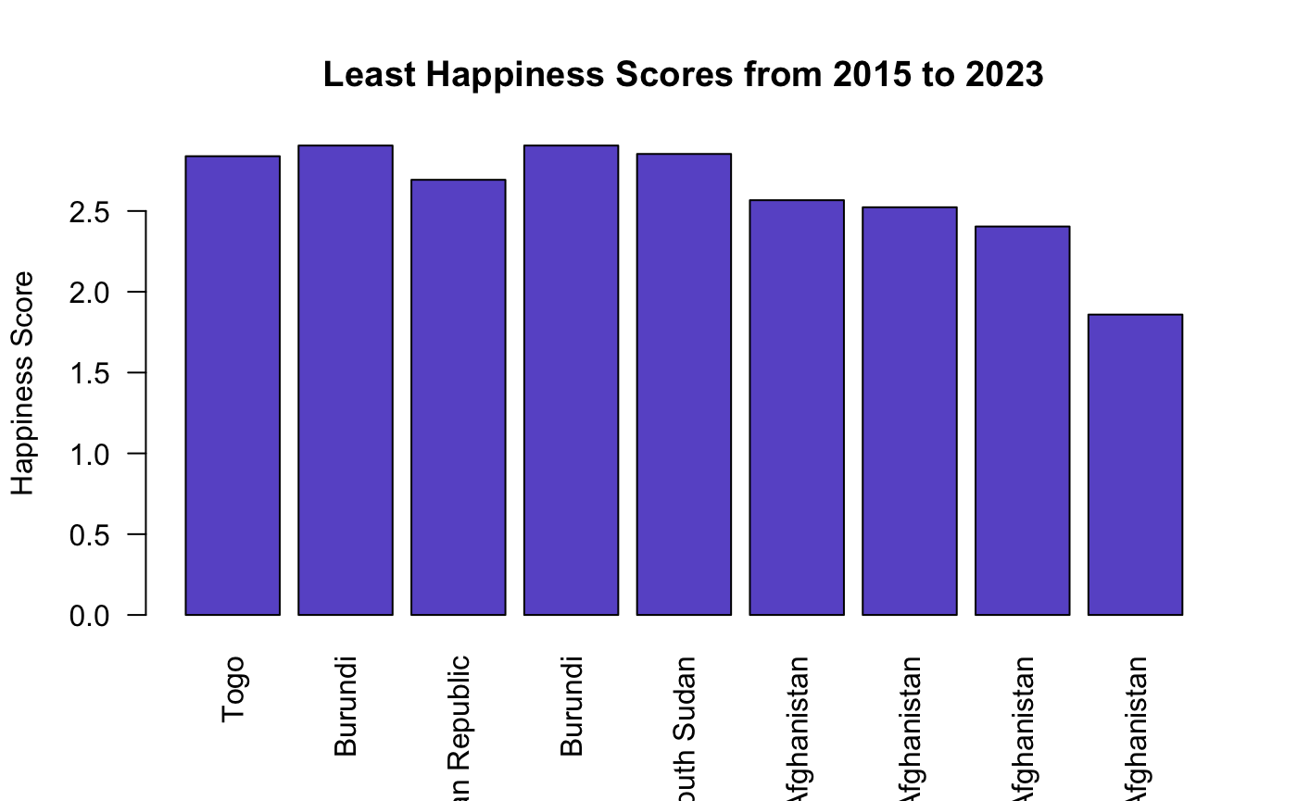
Dataset - Exploratory Analysis

Slide 8
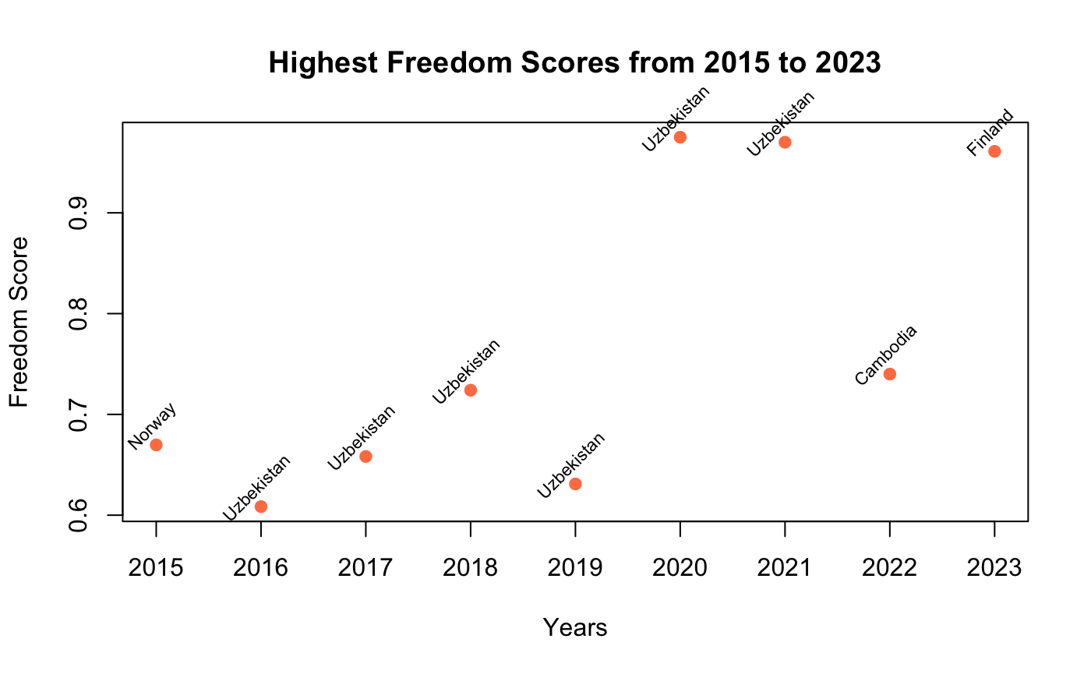
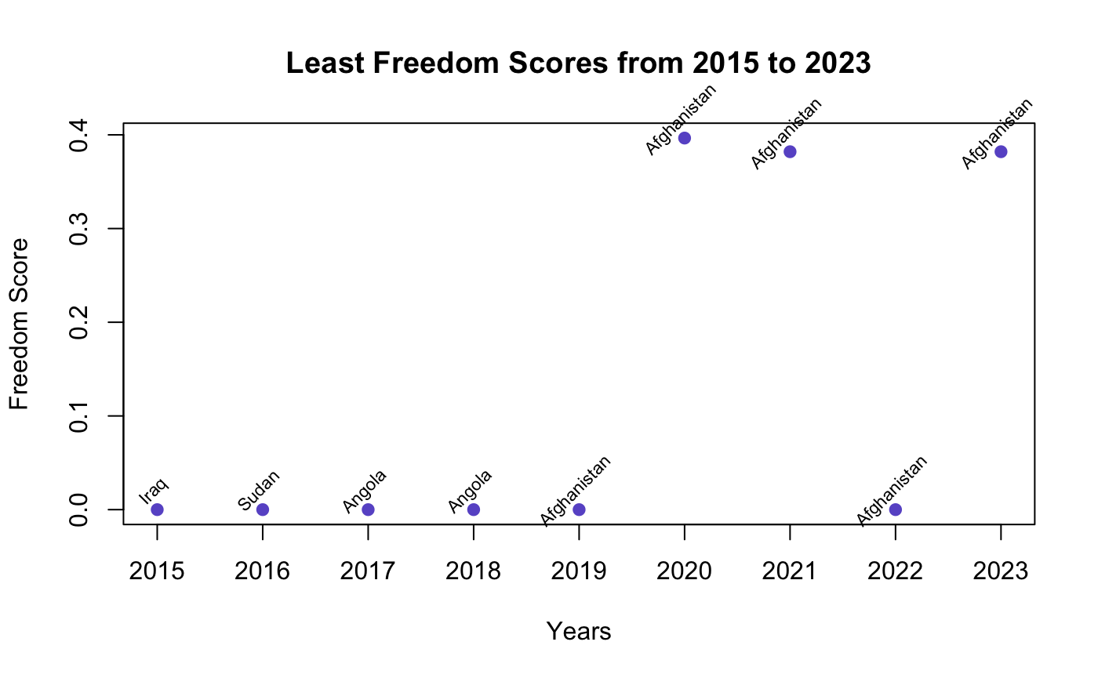
Dataset - Exploratory Analysis

Slide 9
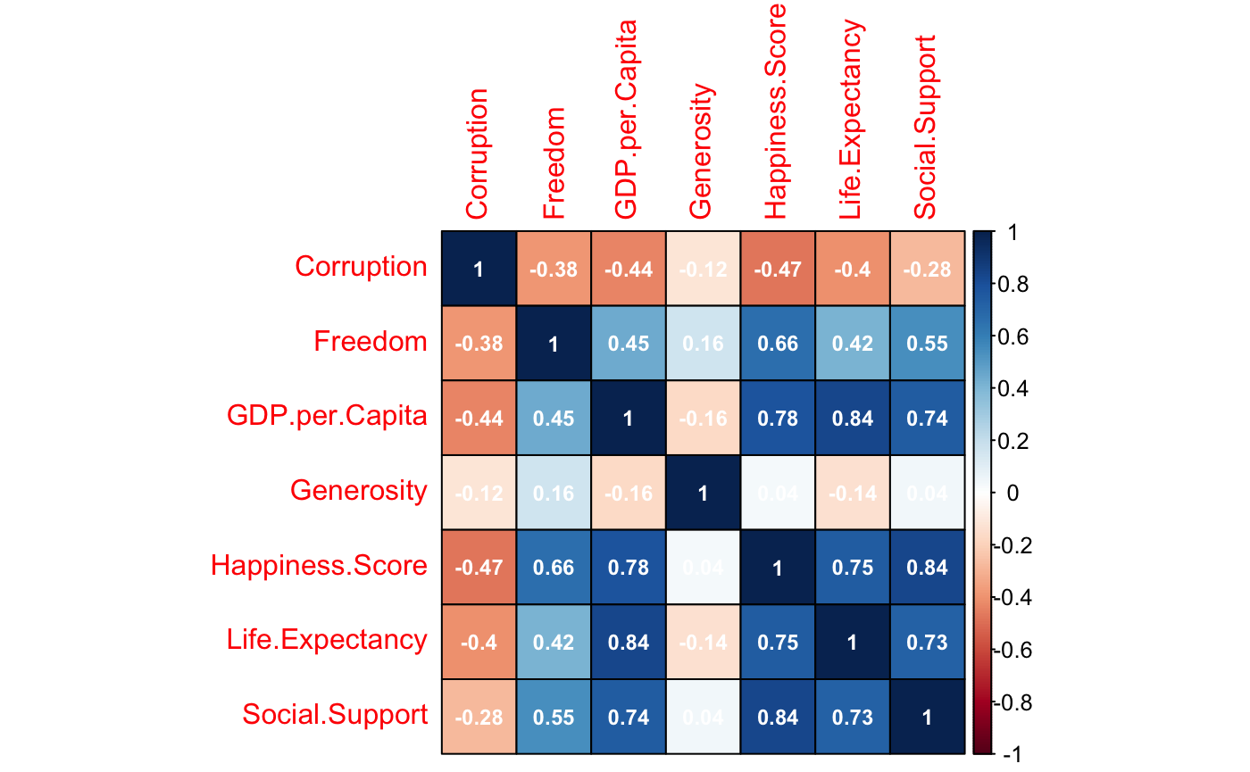
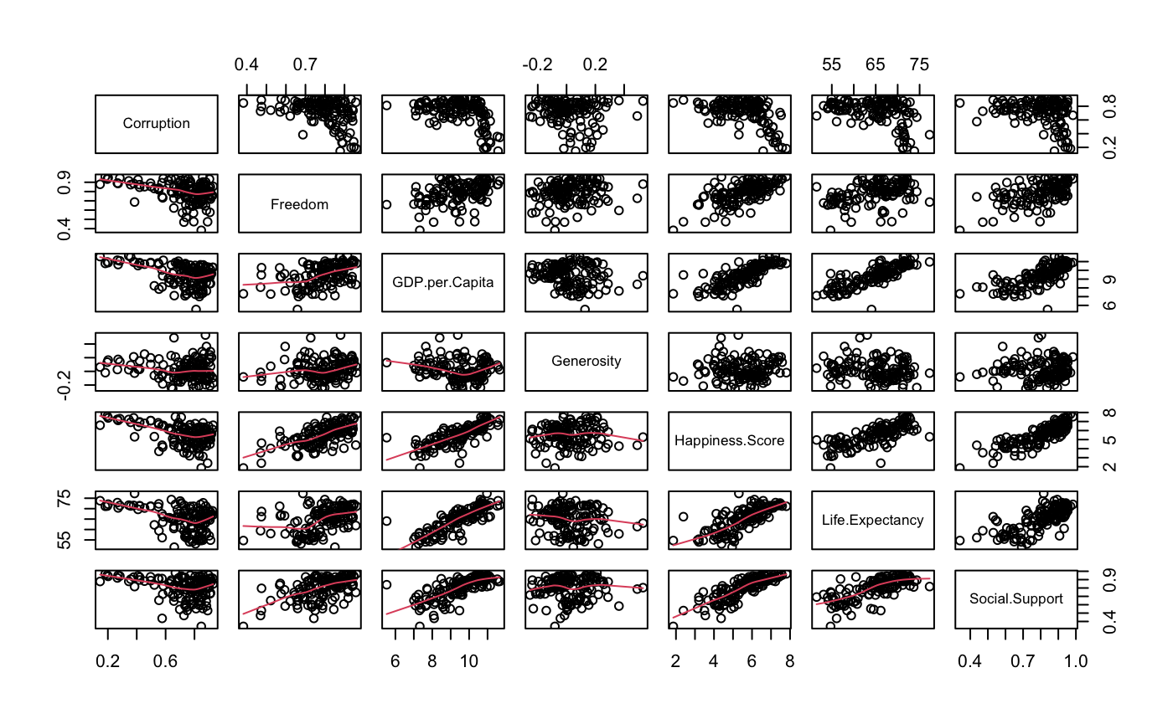
Dataset - Exploratory Analysis (2023)

Slide 10
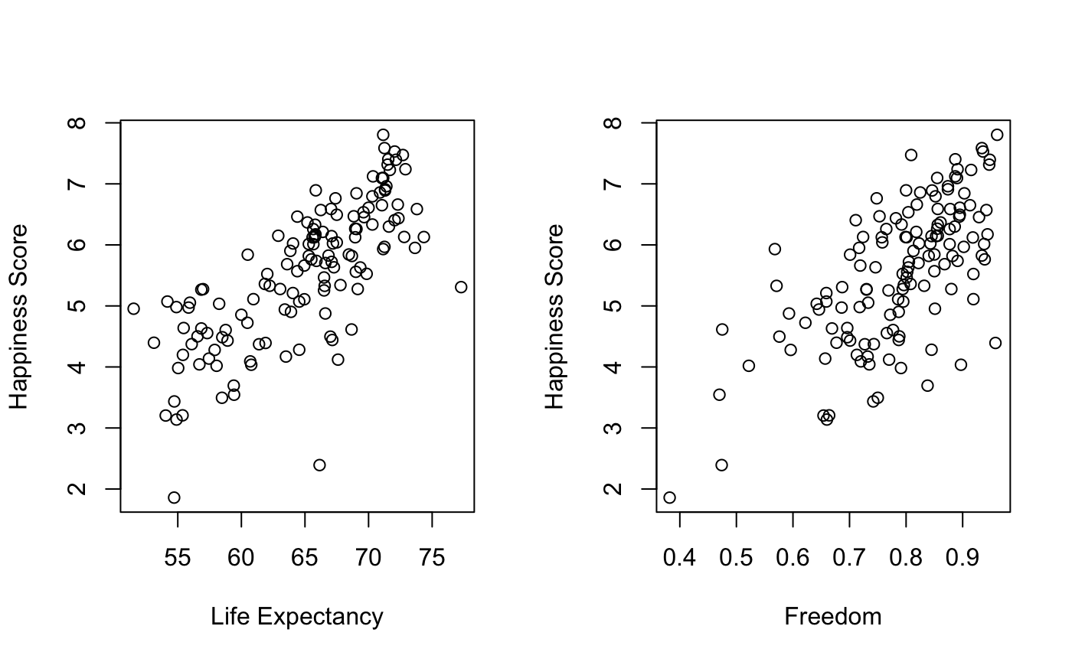
Dataset - Exploratory Analysis (2023)

Slide 11
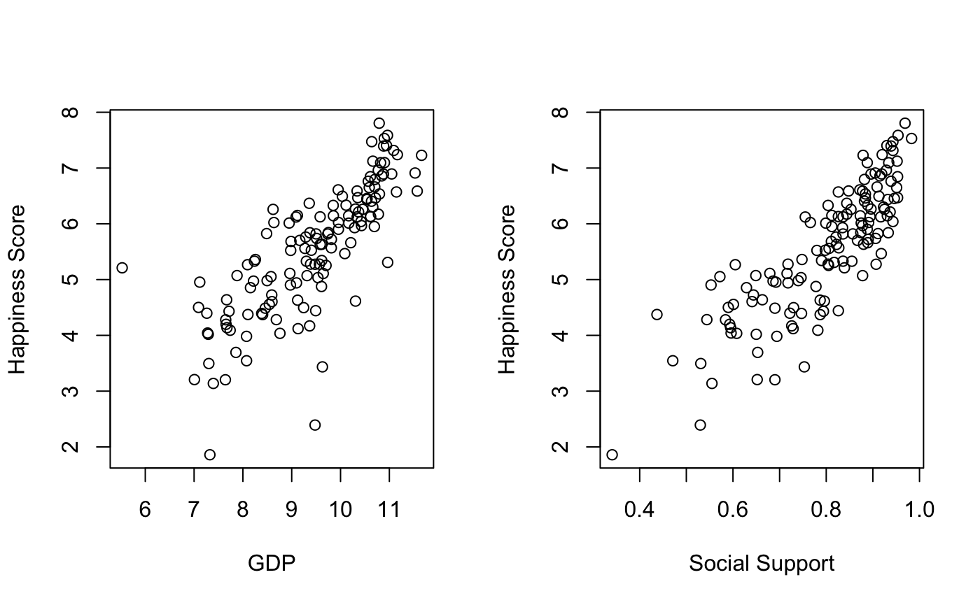
Dataset - Exploratory Analysis (2023)

Slide 12
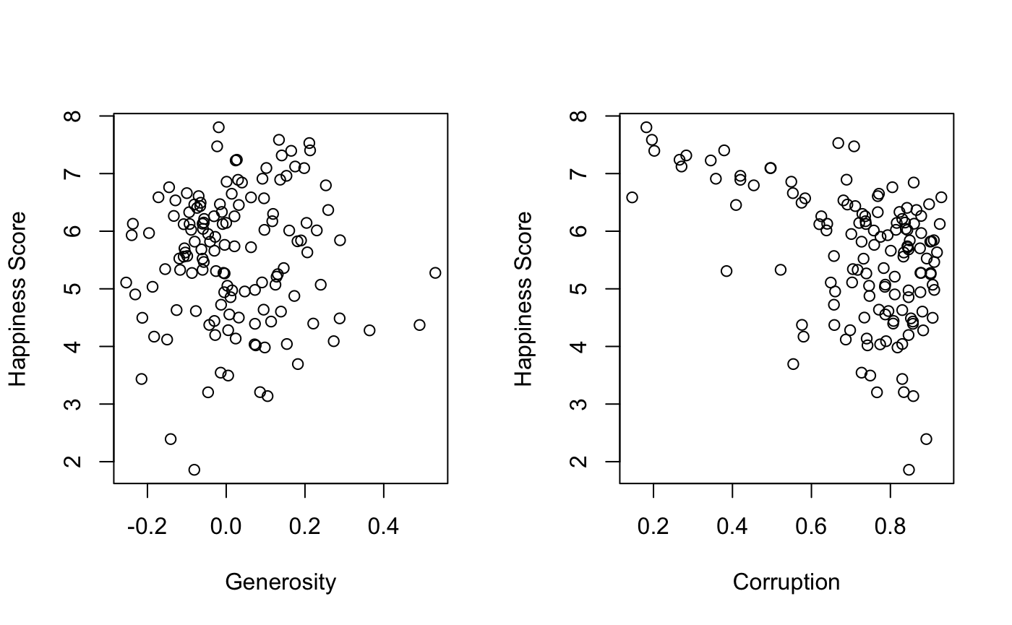
Dataset - Exploratory Analysis (2023)

Slide 13
Dataset - Statistical Analysis (2015 to 2023)
 | Happiness Score | GDP per Capita (10000$) | Social Support | Life Expectancy (Years) | Freedom | Generosity | Corruption
Mean | 5.44 | 3.68 | 0.97 | 21.20 | 0.54 | 0.13 | 0.32
Minimum | 1.85 | 0.00 0.015 | 0.00 0.064 | 0.00 0.0055 | 0.00 0.0058 | -0.30 | 0.00 0.001
Maximum | 7.84 | 11.66 | 1.64 | 77.28 | 0.97 | 0.83 | 0.93

Slide 14
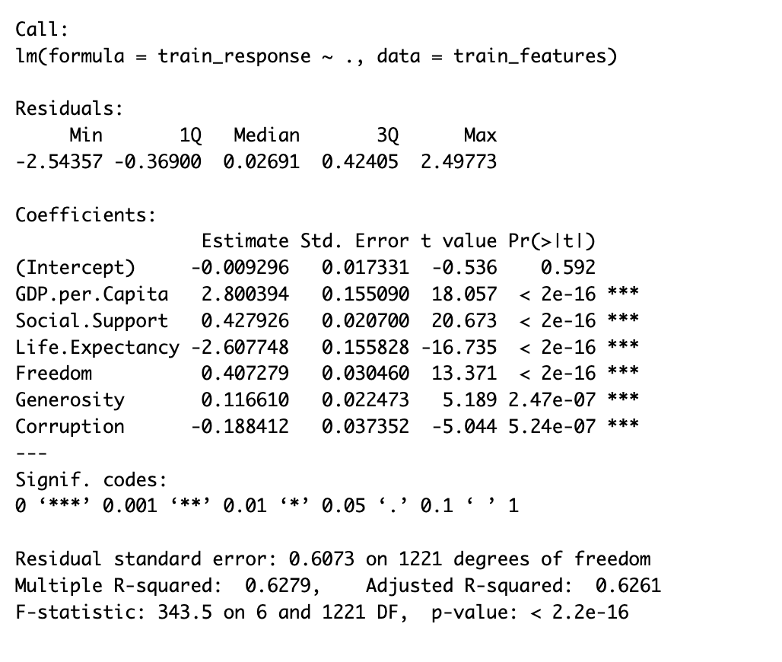
Model - Linear Regression
All predictors are statistically significant.
Adjusted R2 (Train): 0.62
MSE (Train) : 0.36
MSE (Test) : 0.41

Slide 15
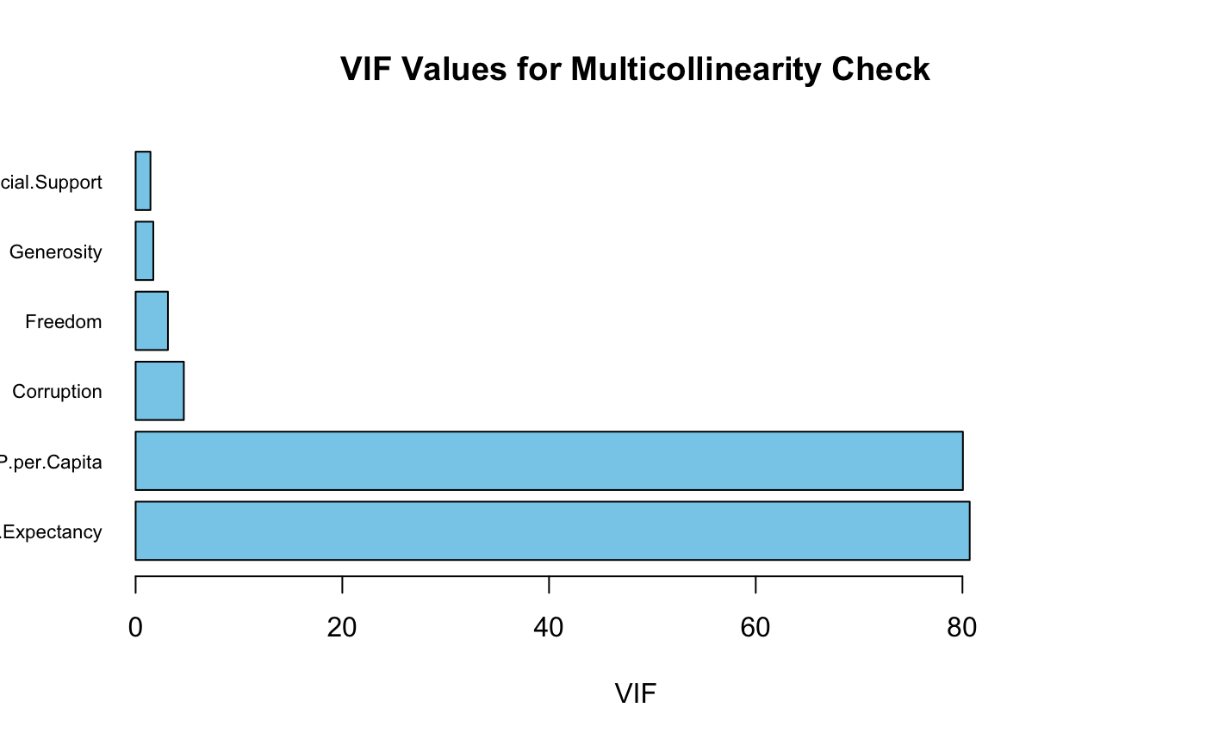
Model - Linear Regression

Slide 16
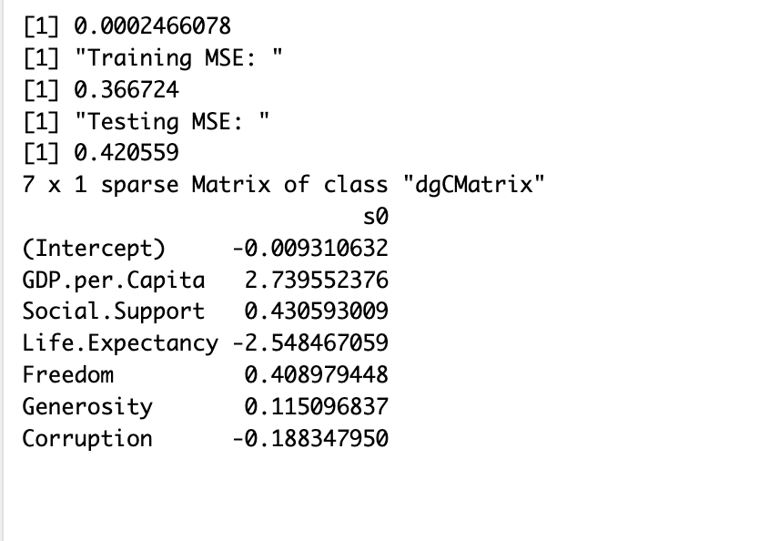
Model - Lasso Regression
The coefficients seems to be penalized the most for GDP and Life Expectancy
MSE (Train) : 0.45
MSE (Test) : 0.51
Optimum lambda (using 20 fold CV) : 0.00024

Slide 17
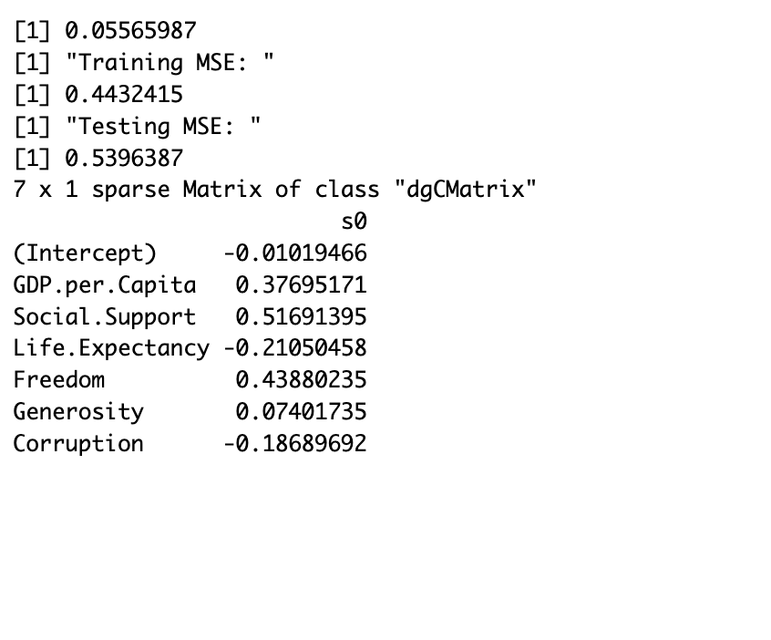
Model - Ridge Regression
The coefficients for GDP and Life Expectancy seems to be penalized the most (more than lasso)
MSE (Train) : 0.44
MSE (Test) : 0.53
Optimum lambda (using 20 fold CV) : 0.055

Slide 18
Results
Models | Train MSE | Test MSE
Linear Regression | 0.36 | 0.41
Lasso Regression (𝛌 =0.000246) | 0.36 | 0.42
Ridge Regression (𝛌 = 0.0556) | 0.44 | 0.53
KNN (N = 9) | 0.16 | 0.26

Slide 19
Discussion and Future Work
Discussion:
Significant multicollinearity exists among the predictors.
Overall, KNN model performed the best with the lowest test MSE of 0.26
Performance of Linear Regression Model and Lasso Regression Model was similar.
However, performance of Ridge Regression was worse among all
GDP and Life Expectancy (among all 6 predictors) appear to be the most important factors affecting happiness score.
Future Work:
Study how influencing factors have changed over the years.
Explore the regional aspect of happiness.
Personalized models with individual preferences to predict happiness

Slide 20
THANK YOU

Slide 21
References
[1] https://worldhappiness.report/
[2] https://www.statlearning.com/
[3] https://www.andreaperlato.com/mlpost/deal-multicollinearity-with-lasso-regression/

Slide 22
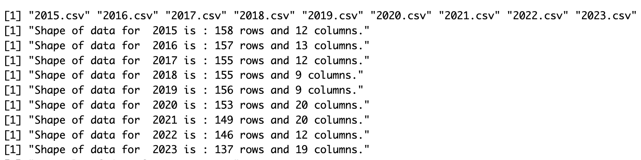
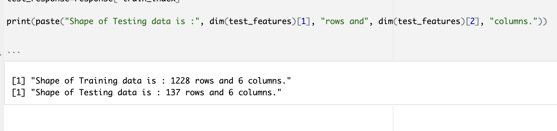
Appendix

Slide 23
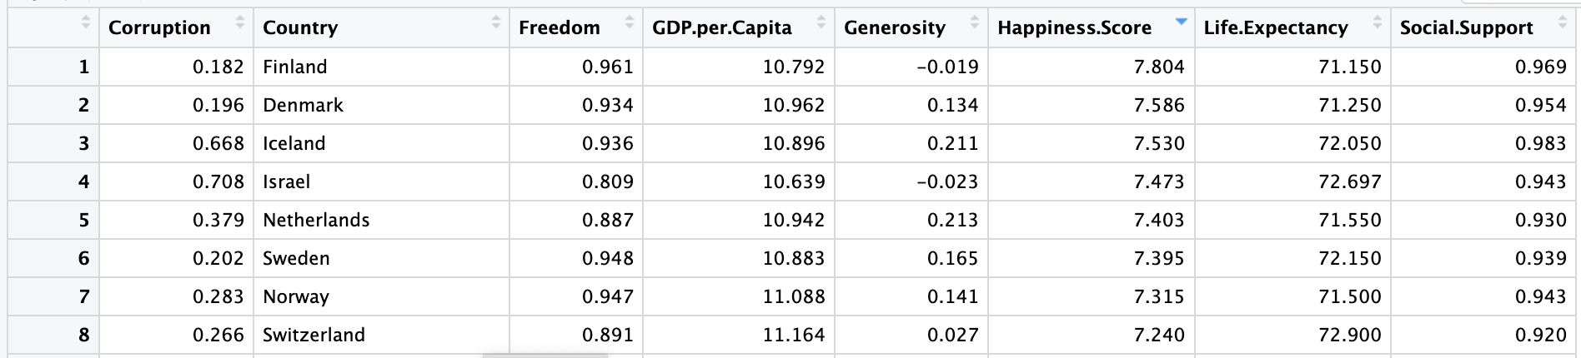
Appendix

Slide 24
Appendix
All Column Names available
Country, Happiness Score,Standard error of ladder score, upperwhisker, lowerwhisker, GDP per Capita, Social Support, LifeExpectancy, Freedom, Generosity, Corruption, Ladder score in Dystopia, Explained by: Log GDP per capita ,Explained by: Social support, Explained by: Healthy life expectancy, Explained by: Freedom to make life choices, Explained by: Generosity, Explained by: Perceptions of corruption, Dystopia + residual

Slide 25
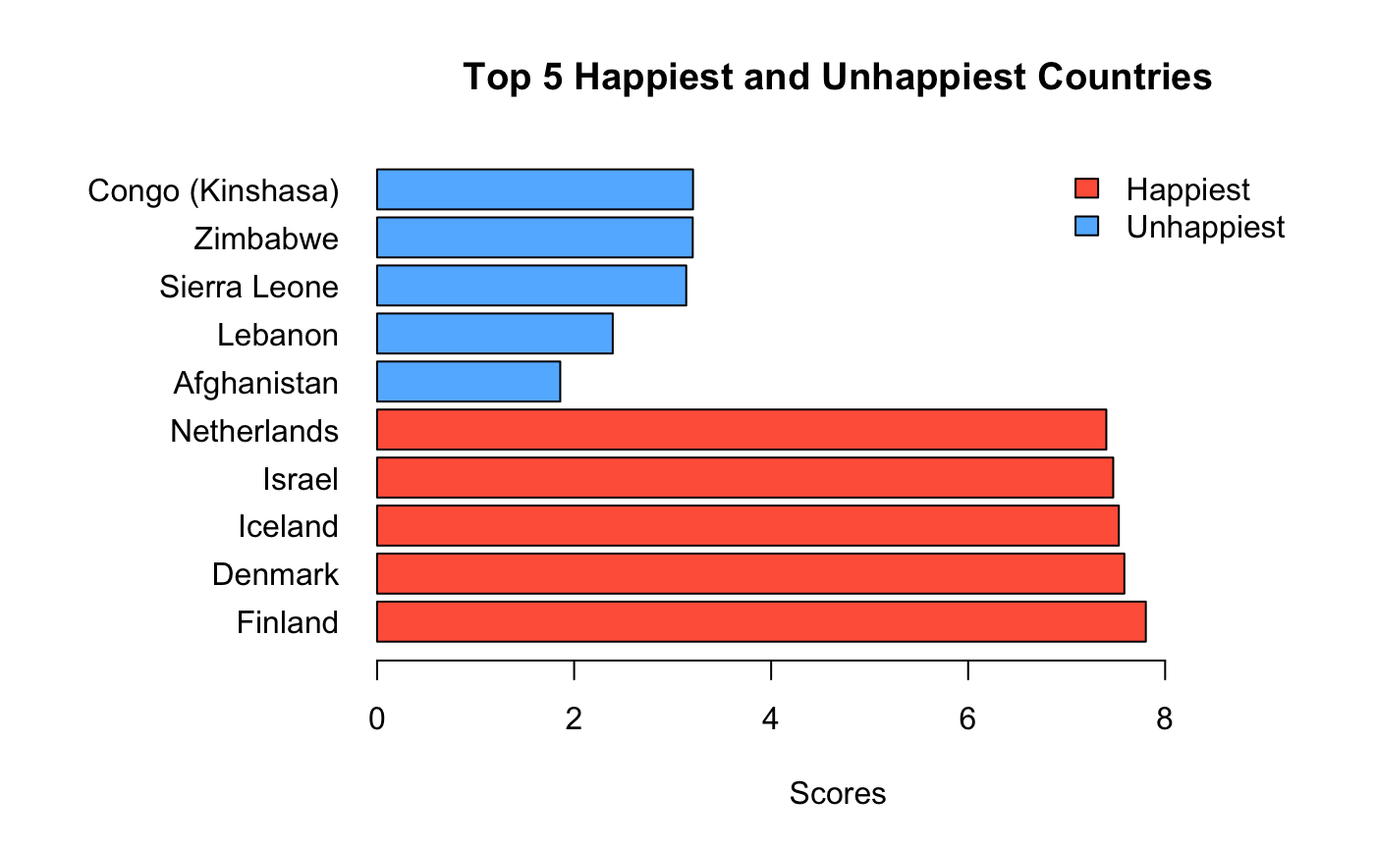
Dataset - Exploratory Analysis (2023)

Slide 26
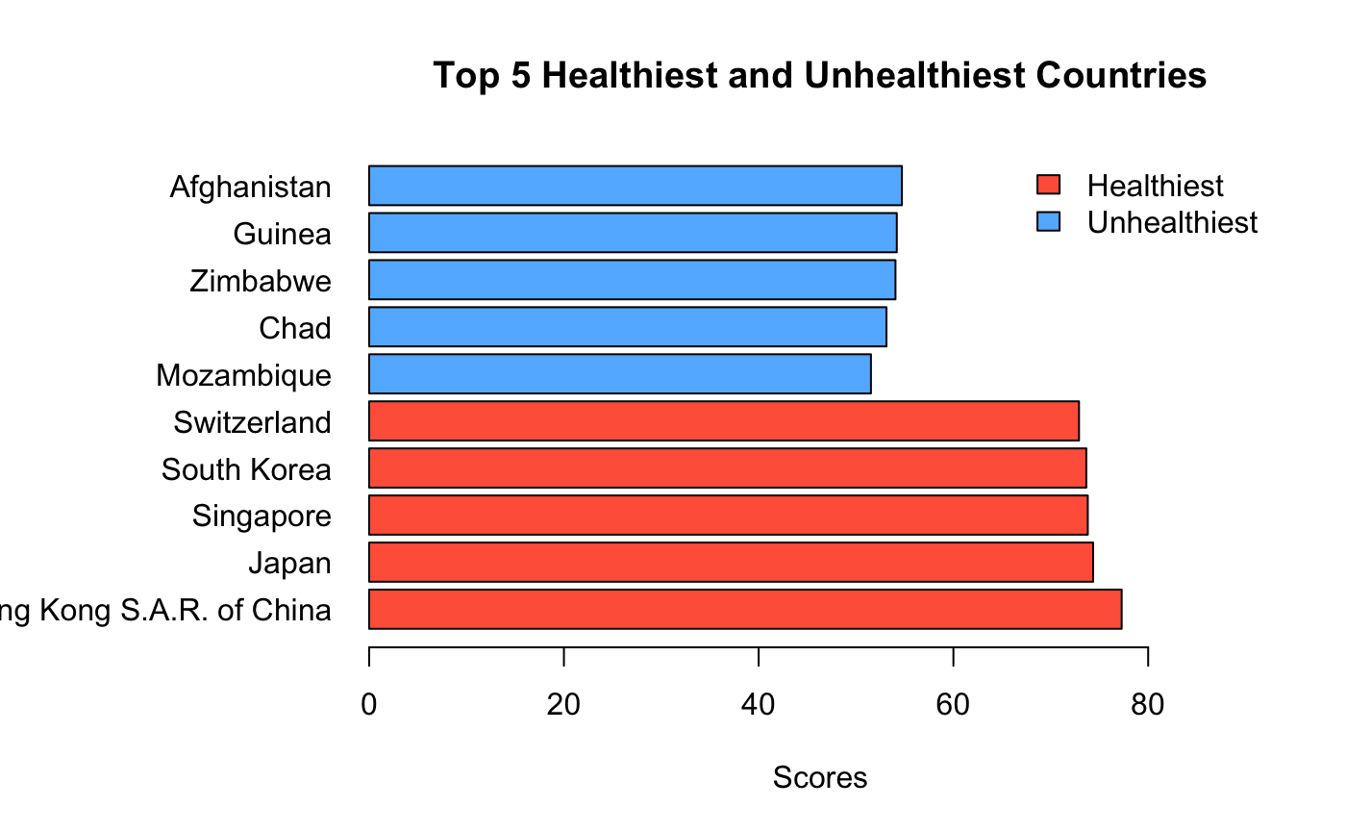
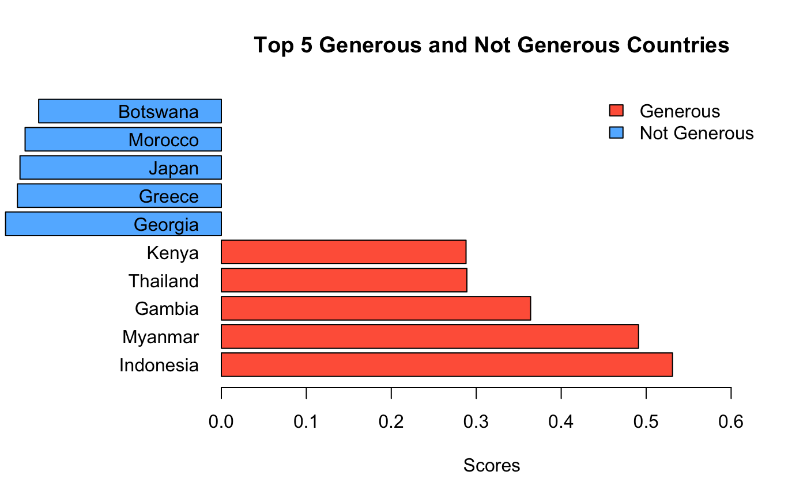
Appendix

Slide 27
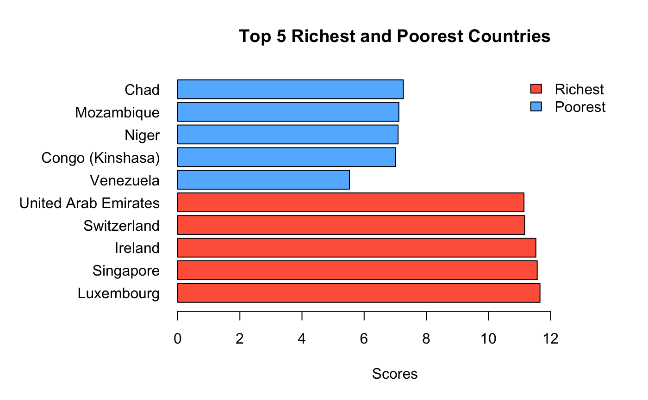
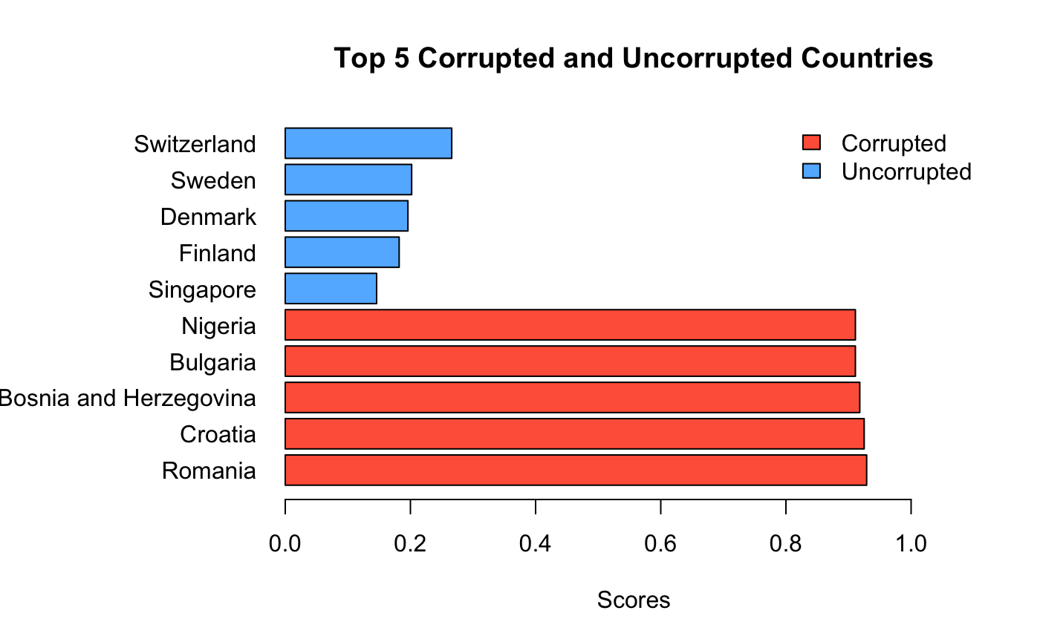
Appendix

Slide 28
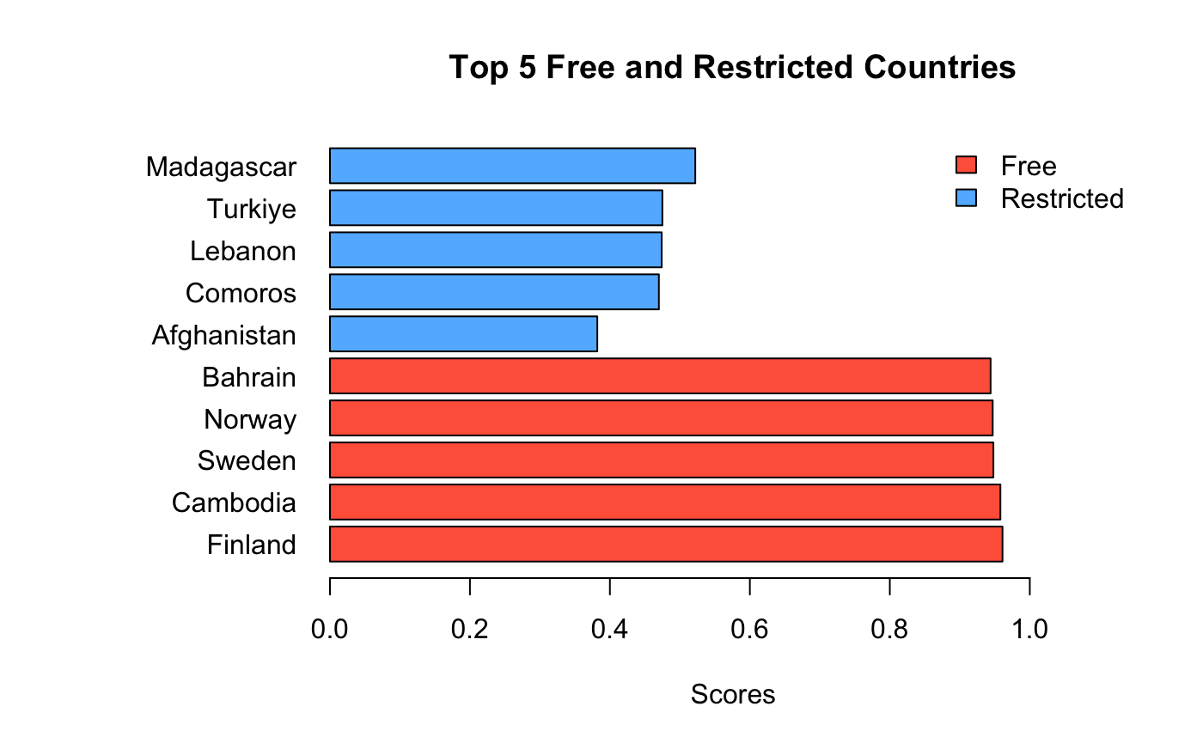
Appendix

Slide 29
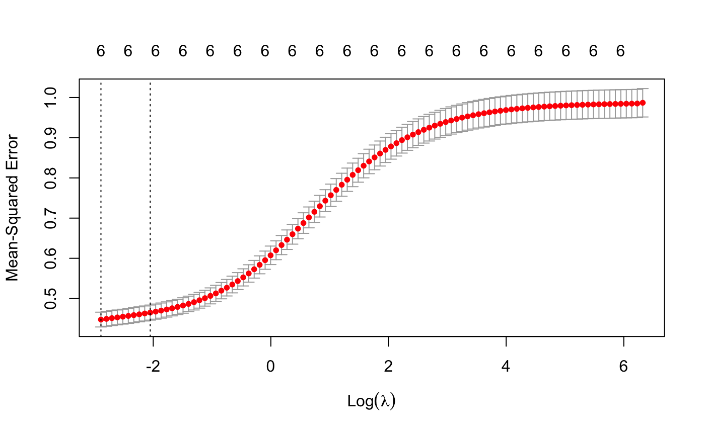
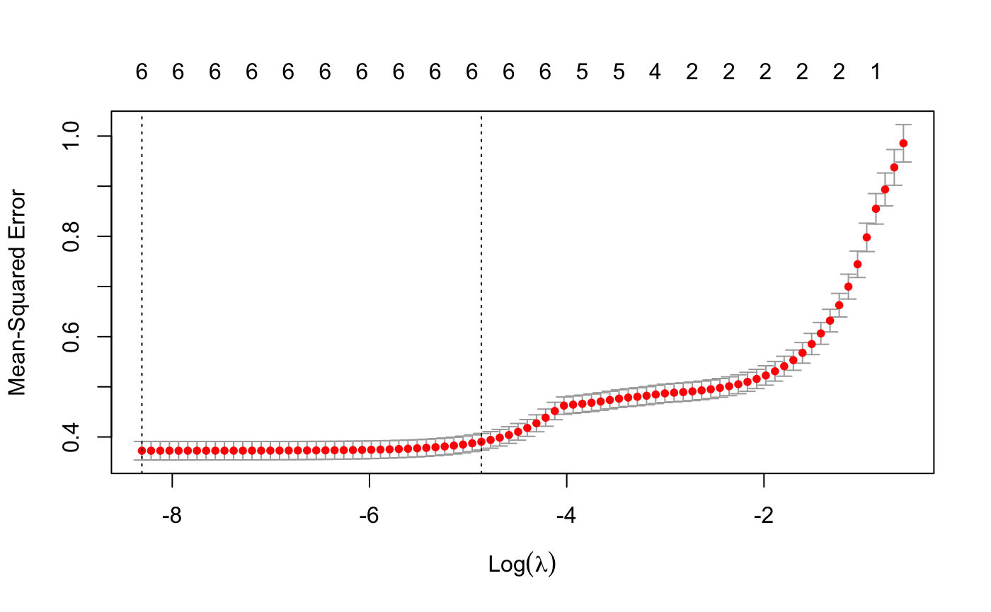
Appendix
Ridge (ƛ =0.055)
Lasso (ƛ = 0.0024)

